Slide 1
Normalisation
INF08104: Database Systems
Brian Davison, 2014/15

Slide 2
Agenda
Data anomalies
Functional dependency
First normal form
Second normal form
Third normal form

Slide 3
Minimising redundancy
Closely related attributes are found in the same relation (table)
Each relation contains a minimum number of attributes
Each attribute value is stored a minimum number of times (ideally only once)

Slide 4
Example data
cons_id | cons_name | grade | daily_rate | days | proj_code | proj_name | start_date | end_date
123 | McAlastair | Senior | 750 | 42 | AB66 | Goldfish | 01-OCT-2011 | 30-JUN-2012
143 | McBeth | Executive | 800 | 12 | DD25 | Silverbird | 01-JAN-2012 | 31-MAY-2012
125 | McCluskey | Junior | 500 | 80 | AB66 | Goldfish | 01-OCT-2011 | 30-JUN-2012
163 | McDowell | Senior | 750 | 65 | GC31 | Bronzecat | 15-FEB-2012 | 15-JAN-2013
167 | McEwan | Executive | 800 | 10 | GC31 | Bronzecat | 15-FEB-2012 | 15-JAN-2013
123 | McAlastair | Senior | 750 | 42 | GC31 | Bronzecat | 15-FEB-2012 | 15-JAN-2013
cons_proj(cons_id, proj_code, cons_name, grade, daily_rate, days,
proj_name, start_date, end_date)
Correct: accurate with respect to reality
Complete: no missing data
Consistent: no internal disagreements

Slide 5
Insertion anomalies
cons_id | cons_name | grade | daily_rate | days | proj_code | proj_name | start_date | end_date
123 | McAlastair | Senior | 750 | 42 | AB66 | Goldfish | 01-OCT-2011 | 30-JUN-2012
143 | McBeth | Executive | 800 | 12 | DD25 | Silverbird | 01-JAN-2012 | 31-MAY-2012
125 | McCluskey | Junior | 500 | 80 | AB66 | Goldfish | 01-OCT-2011 | 30-JUN-2012
163 | McDowell | Senior | 750 | 65 | GC31 | Bronzecat | 15-FEB-2012 | 15-JAN-2013
167 | McEwan | Executive | 800 | 10 | GC31 | Bronzecat | 15-FEB-2012 | 15-JAN-2013
123 | McAlastair | Senior | 750 | 42 | GC31 | Bronzecat | 15-FEB-2012 | 15-JAN-2013
Cannot insert consultant without project
Cannot insert project without consultant
Data is no longer correct

Slide 6
Deletion anomalies
cons_id | cons_name | grade | daily_rate | days | proj_code | proj_name | start_date | end_date
123 | McAlastair | Senior | 750 | 42 | AB66 | Goldfish | 01-OCT-2011 | 30-JUN-2012
143 | McBeth | Executive | 800 | 12 | DD25 | Silverbird | 01-JAN-2012 | 31-MAY-2012
125 | McCluskey | Junior | 500 | 80 | AB66 | Goldfish | 01-OCT-2011 | 30-JUN-2012
163 | McDowell | Senior | 750 | 65 | GC31 | Bronzecat | 15-FEB-2012 | 15-JAN-2013
167 | McEwan | Executive | 800 | 10 | GC31 | Bronzecat | 15-FEB-2012 | 15-JAN-2013
123 | McAlastair | Senior | 750 | 42 | GC31 | Bronzecat | 15-FEB-2012 | 15-JAN-2013
Deleting McBeth means losing data about project Silverbird
Data is no longer complete

Slide 7
Update anomalies
cons_id | cons_name | grade | daily_rate | days | proj_code | proj_name | start_date | end_date
123 | McAlastair | Senior | 750 | 42 | AB66 | Goldfish | 01-OCT-2011 | 30-JUN-2012
143 | McBeth | Executive | 800 | 12 | DD25 | Silverbird | 01-JAN-2012 | 31-MAY-2012
125 | McCluskey | Junior | 500 | 80 | AB66 | Goldfish | 01-OCT-2011 | 30-JUN-2012
163 | McDowell | Senior | 750 | 65 | GC31 | Bronzecat | 15-FEB-2012 | 15-JAN-2013
167 | McEwan | Executive | 800 | 10 | GC31 | Bronzecat | 15-FEB-2012 | 15-JAN-2013
123 | McAlastair | Senior | 750 | 42 | GC31 | Bronzecat | 15-FEB-2012 | 15-JAN-2013
Updating McAlastair's rate in row 2 may leave a different value in row 7
Data is no longer consistent

Slide 8
Functional dependency
student_results(matric_no, first_name, last_name, programme, module_code, module_title, school, result)
matric_no | f_name | l_name | programme | mod_code | mod_title | school | result
10001234 | Ed | Edwards | BEng Computing | SET07101 | Agile App Development | Computing | 69
10001234 | Ed | Edwards | BEng Computing | SET07102 | Software Development 1 | Computing | 72
10010123 | Jo | Jones | BIS | SET07101 | Agile App Development | Computing | 64
10010123 | Jo | Jones | BIS | SOE07101 | Business Skills | Business | 70
10104321 | Pete | Peters | Management | SOE07101 | Business Skills | Business | 70
10012222 | Pete | Peters | English | JAC07109 | Social Media | Arts | 68

Slide 9
Functional dependency
matric_no | f_name | l_name | programme | mod_code | mod_title | school | result
student_results(matric_no, first_name, last_name, programme, module_code, module_title, school, result)

Slide 10
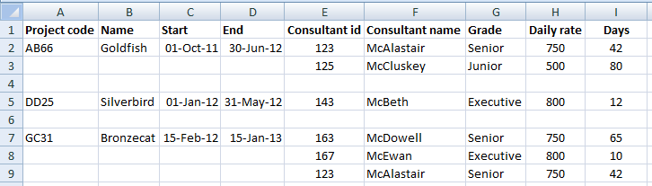
First normal form
All attributes must be atomic
There must be no repeating groups of attributes
There must be a primary key
All non-key attributes must be functionally dependent on the primary key

Slide 11
Repeating groups 1
AB66
Goldfish
01-OCT-11
30-JUN-12
GC31
Bronzecat
15-FEB-12
15-FEB-13
GC31
Bronzecat
15-FEB-12
15-FEB-13
Flatten the data by copying down repeating values

Slide 12
First normal form
proj_code | proj_name | start_date | end_date | cons_id | cons_name | grade | rate | days
cons_proj(proj_code, cons_id, proj_name, cons_name,
start_date, end_date, grade, rate, days)

Slide 13
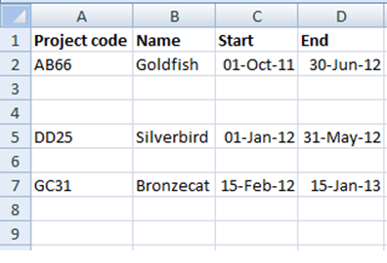
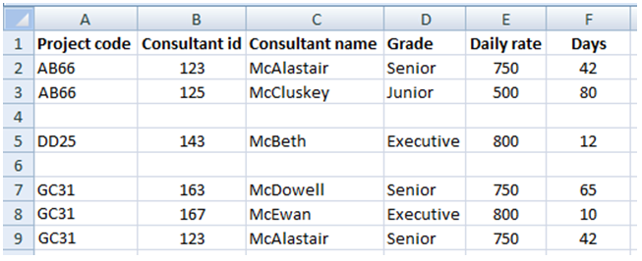
Repeating groups 2
Separate the data into two entities
Identify the PK for each
Retain the PK from the single group as FK in repeating group

Slide 14
Second normal form
proj_code | proj_name | start_date | end_date | cons_id | cons_name | grade | rate | days
There must be no partial dependencies

Slide 15
Second normal form
proj_code | proj_name | start_date | end_date
proj_code | cons_id | days
cons_id | cons_name | grade | rate
consultant(cons_id, cons_name, grade, daily_rate)
project(proj_code, proj_name, start_date, end_date)
cons_proj(proj_code, cons_id, days)

Slide 16
Third normal form
proj_code | proj_name | start_date | end_date
proj_code | cons_id | days
cons_id | cons_name | grade | rate
There must be no transitive dependencies

Slide 17
Third normal form
proj_code | proj_name | start_date | end_date
proj_code | cons_id | days
cons_id | cons_name | grade
grade | rate
consultant(cons_id, cons_name, grade)
grade(grade, daily_rate)
project(proj_code, proj_name, start_date, end_date)
cons_proj(proj_code, cons_id, days)

Slide 18
Solution
grade
belongs_to
grade
daily_rate
1..1
0..*
consultant
project
cons_id
cons_name
grade
proj_code
proj_name
start_date
end_date
1..1
assignment
1..1
works_on
cons_id
proj_code
days
has_staff
0..*
0..*

Slide 19
Summary: recognising normal form
Repeating groups or non-atomic values?
Data is un-normalised
No primary key?
Data is un-normalised
Partial dependencies?
Data is in 1NF
Transitive dependencies?
Data is in 2NF
None of the above?
Data is in 3NF

Slide 20
Summary: normalising data
Un-normalised ➔ 1NF
Remove repeating groups (if present)
Identify primary key
1NF ➔ 2NF
Remove partial dependencies (if present)
2NF ➔ 3NF
Remove transitive dependencies (if present)

Slide 21

Short break

Slide 22


Tutorial
Normalisation examples
Word template
Excel template

